Slide 1
Celebrating
Read Across America
Dr. Seuss

Slide 2
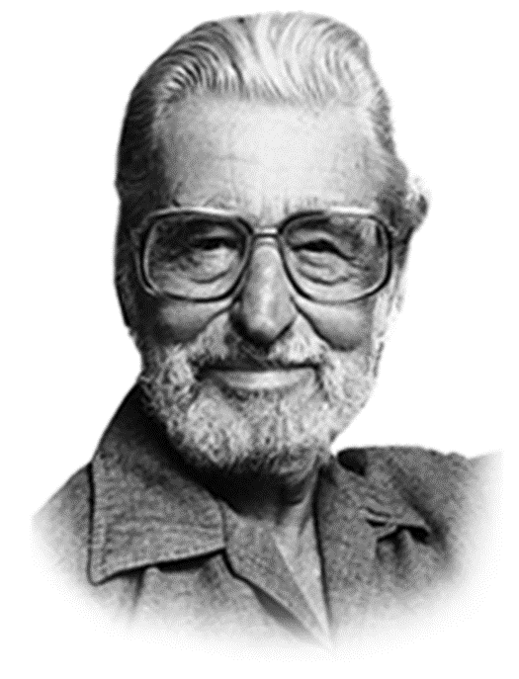
Who is Dr. Seuss?
Dr. Seuss was

Slide 3
One of my favorite books by Dr. Seuss is….
Name of book

Slide 4
Another one of my favorite books by Dr. Seuss is….
Name of book

